Slide 1
Forensic Science: Introduction
Forensic Science - Application of the scientific method and techniques to law and criminal justice.
Encompasses many fields: Chemistry, Physics, Biology, Earth Sciences, Mathematics, Psychology, Anthropology, etc…

Slide 2
History
Began formally in late 1700’s.
Real application of the scientific method and techniques in 1900’s.
Important Names:
  Sung T’zu
  Mathieu Orfila (toxicology)
  Aphonse Bertillion (anthropometry)
  Francis Galton (Fingerprinting)
  Leone Lattes (blood grouping)
  Calvin Goddard (Ballistics)
  Alexndre Lacassagne (anthropology)
  Edmond Locard (scientific criminal investigation)
  Crime Writers: A.C. Doyle, A.Christie

Slide 3
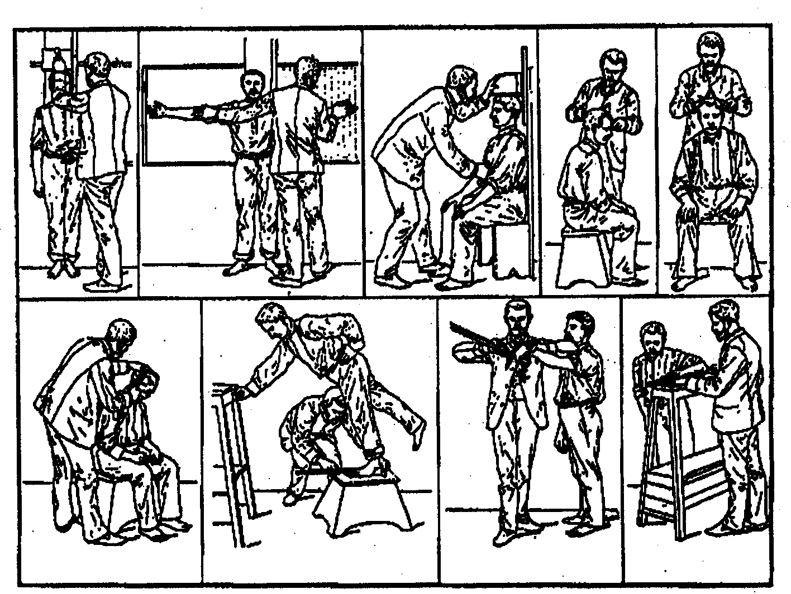
Aphonse Bertillion
Bertillon Measurements

Slide 4
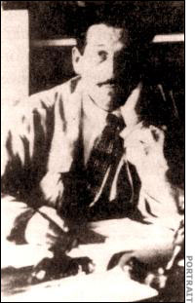
Edmond Locard
1877-1966 Application of scientific techniques to criminal investigations.
Set up first real forensics lab.

Slide 5
Locard’s Exchange Principle
The most basic concept of Forensic Science:
  When a criminal in contact with an object or person at a crime scene, a cross transfer of evidence occurs
    Examples: dust, biological samples, fingerprints, chemical residues, etc.
Links a person to the crime scene

Slide 6
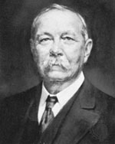
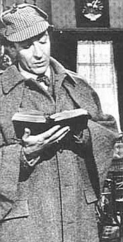
Arthur Conan Doyle
Creator of Sherlock Holmes - Based upon real life Prof. Joe Bell (U. Edinburgh).
Preceded and foretold many chemical analyses for forensic investigations

Slide 7
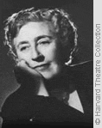

Agatha Christie
Creator of Hercule Poirot and Miss. Jane Marple.
Most read of crime/forensics writers

Slide 8
Scientific Method
Form and test
hypothesis
Patterns and
Trends
Theory
Observations
and Experiments

Slide 9
Multidisciplinary Approach
Natural
Science:
Biology
Physical Science
Chem, Physics
Medicine
Forensic
Science
Engineering
Social Science
Psych, Anthr.
Law
Enforcement

Slide 10
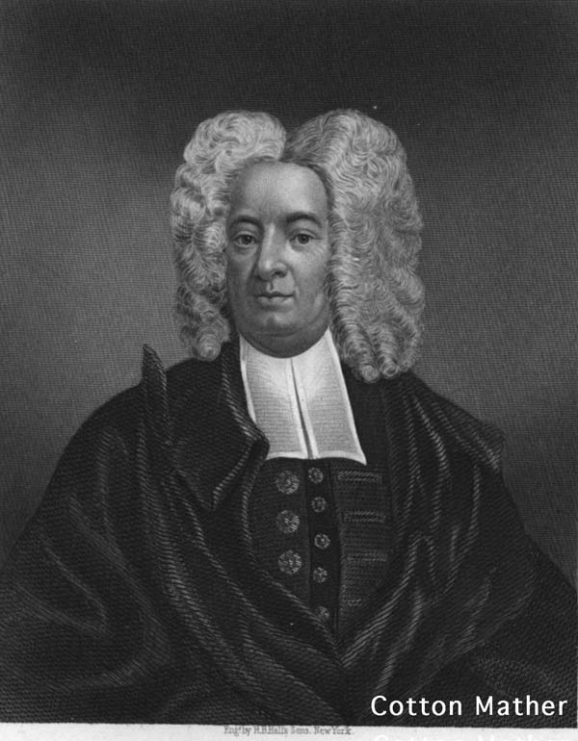
Multidisciplinay Approach and Needs of Forensic Science – Salem Witch Trials
In February of the exceptionally cold winter of 1692, Betty Parris became strangely ill
Flue-like symptoms
She dashed about, contorted in pain, and complained of fever.
Strange dances that continued until exhaustion/collapse
Cotton Mather published a popular book, "Memorable Providences," describing the suspected witchcraft of an Irish washerwoman in Boston, and Betty's behavior mirrored that of the afflicted person .

Slide 11
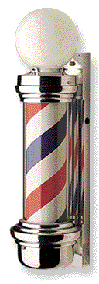
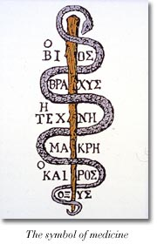
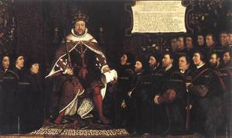
1690 Medicine
King Henry VIII signed a decree merging two groups into the Great Company of Barbers and Surgeons.

Slide 12

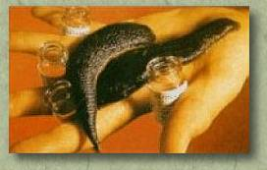
1690 Medicine
External Injury:
Amputation:
Most died of blood-loss, shock, or infection.
Internal Illness:
Illness was cause by an imbalance in blood, bile, phlegm

Slide 13
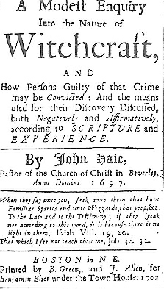
Salem Witch Trials
June through September of 1692:
  19 men and women, convicted of witchcraft, were hung on Gallows Hill near Salem Village.
  An 80-yr. old man - pressed to death under heavy stones.
  Hundreds of others faced accusations of witchcraft.
  Dozens languished in jail for months without trials.
Late 1692, the hysteria that swept through Puritan Massachusetts ended.

Slide 14
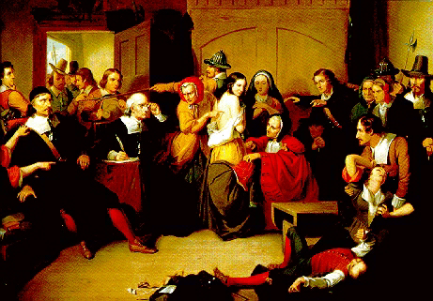
“Examination of a Witch”

Slide 15
Ergotism (St. Anthony’s Fire)
Ergot - A toxic fungus found as a parasite on grains of rye.
Gangrenous ergotism (gang-green) - nausea, pains in the limbs, bodily extremities turn black, dry and become mummified
Hallucinogenic ergotism - vivid hallucinations nervousness, physical and mental excitement, insomnia and disorientation, strange dances with wild, jerky movements accompanied by hopping, leaping, screaming, and dancing compulsively until exhaustion lead them to collapse unconscious.

Slide 16
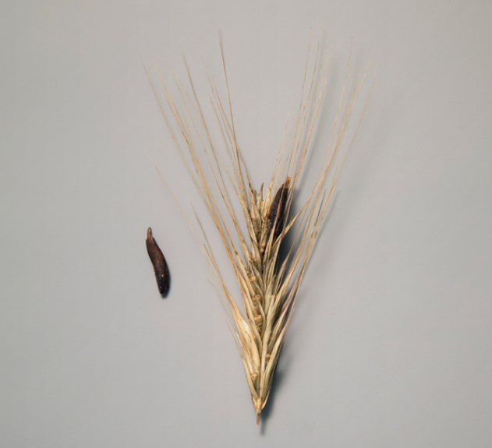
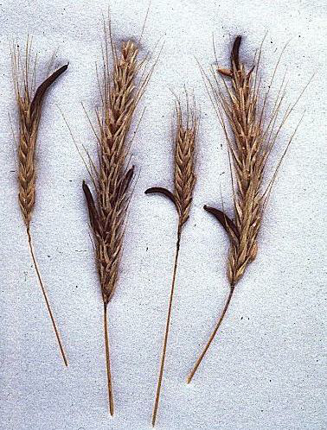
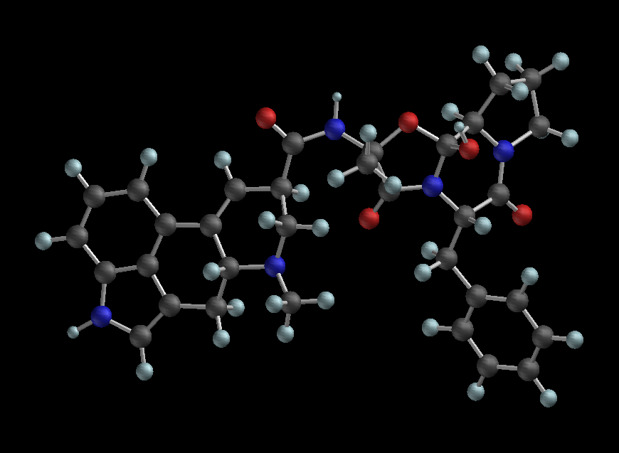
Ergotism
Ergotamine tartrate
Ergot on grains of rye

Slide 17
Ergotism
Ergotamine tartrate
Lysergic acid diethylamide

Slide 18
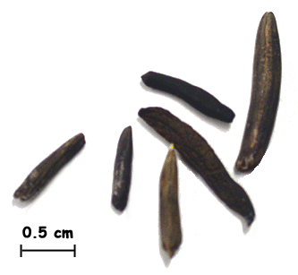
Localization
Weather
Timing
Symptoms (including recovery)
Accounts for full series of events
Others

