Slide 1
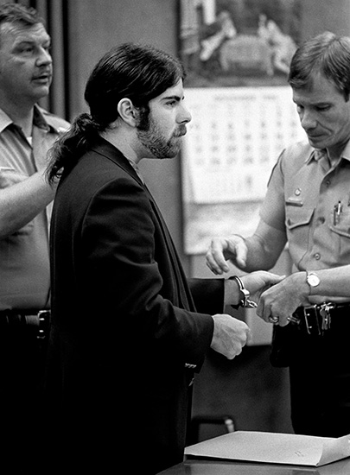
Vicki Lynn Hoskinson Case

Slide 2
Background
Monday, September 17, 1984: 8 year old, Vicki Lynn Hoskinson left home to mail a birthday card to her aunt
This was the first time Debbie Carlson had allowed her to go out on her own
About 20 minutes later, Vicki's sister Stephanie arrived home
Carlson asked Stephanie to look for Vicki
While out searching, Stephanie found Vicki's bike lying on the side of the road (this was surprising because Vicki had adored the bike and cared for it like a prized possession)
Vicki's mother put the bike in her car and called the Pima County sheriff and her husband home from work.

Slide 3
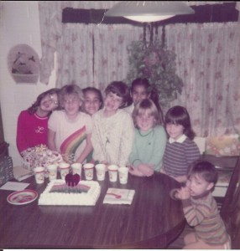
Search and possible sightings
Deputies went to the post
office. The manager
recognized Vicki from previous
visits but said he had not seen
her that day.
Deputies went to Vicki’s friend
Jennifer's house. Jennifer's
younger brother said Vicki had
stopped by earlier looking for
Jennifer. After telling her she was
not home Vicki left riding towards her house.
Two older boys approached the deputy claiming they saw a small black car with a California license plate. They said the car was heading in Vicki's direction

Slide 4
A toy store clerk at the Tucson mall called the command center stating she saw a woman with an upset little girl who resembled Vicki. The woman wore a wide brimmed hat and was carrying a shopping bag from another store in the mall
Investigators went to Vicki's neighborhood to see if anyone recognized the woman (from a sketch), but no one did. Debbie Carlson said that Vicki would not walk with a stranger and would try to run away. This raised the idea that Vicki perhaps knew her abductor.
A woman who lived across the street from where Vicki's bicycle had been found brought her son in to tell police that he had reported seeing a "bicycle being knocked down by a black racecar“
Agents checked the area where Vicki's bike was found, and found a fresh gouge on a mailbox post and believed this to be from the car that had allegedly hit Vicki's bike.
After questioning possible witnesses, Sam Hall, a coach at an elementary school, stated he saw a suspicious vehicle at the schoolyard on September 17 (20 minutes before Vicki was last seen). He saw a California license plate and wrote it down. He noticed the driver was watching the children play, and described the driver as male with long hair rising on the back of his neck and a beard.

Slide 5
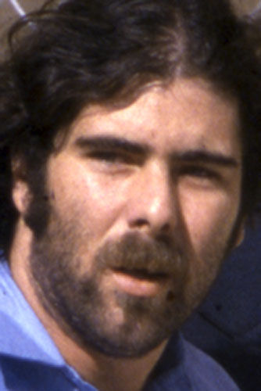
Frank Jarvis Atwood
The trace on the license plate lead to a 28 year old Los Angeles man named Frank Jarvis Atwood.
Frank Atwood was out on parole in California for kidnapping and child molestation charges.
The car was registered to Frank Jarvis Atwood’s father.
When investigators went to his parent’s house, they said their son had visited earlier but didn't know where he had gone afterwards.
A few hours later, Atwood called his parents stating his car broke down in Texas and needed money to get it fixed.
His mother wrote down the address and his father went outside to a payphone to call the FBI
Agents in Arizona called agents in Texas to apprehend Frank Atwood. Agents arrested Atwood and his traveling companion James McDonald in Kerrville, Texas at the service station

Slide 6
Questioning
Atwood and McDonald were brought in for questioning
During questioning, Atwood told investigators he was in Vicki's neighborhood on September 17th staying in a nearby park.
About 3:00 PM, he left to buy drugs and returned to the park about 5:00PM
James McDonald corroborated Atwood's story, and told investigators that he and Atwood had an argument in the park about 3:00.
Atwood left for 2 hours and returned with bloodstains on his hands and clothing. He told McDonald he got into a fight with a drug dealer and stabbed him.
Investigators searched the trailer Atwood was staying in, and found a bloodstained blanket and a hairbrush. Both were subjected to blood and fiber tests and proved nothing in connection with Vicki's disappearance. Atwood's clothes and knife were never found.
The search for evidence continued. Detectives revisited the park where Atwood had stayed. They found a couple that knew Atwood who said that Atwood had bloodstained clothes the day Vicki disappeared. Atwood told them he had stabbed a double-crossing drug dealer.

Slide 7
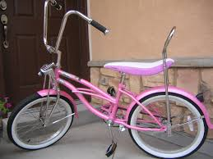
Evidence against Atwood
Investigators had corroborating stories that suggested Atwood's guilt but required physical evidence.
They compared hair samples from Vicki's bedroom and hair found in the car… no match.
Investigators found pink paint on the front bumper of Atwood's car
After comparing the paint on the car to a sample of pink paint from Vicki's bike, it was determined to be a “match”
Chrome plating from the bumper was found smeared on the bike

Slide 8
Trial
Almost three weeks after Vicki's disappearance, Atwood was arrested and charged with kidnapping.
Because of the publicity of the case in Tucson, the judge ordered the trial to be moved to Phoenix. Jury selection took almost 6 weeks.
On December 3, 1984, Atwood pleaded not guilty to kidnapping charges.

Slide 9
Discovery of remains
On April 12, 1985, a woman walking her dog found a small human skull in the desert northwest of Tucson
Dental records confirmed they were Vicki's remains.
Atwood was indicted on 1st degree murder and was found guilty
He was sentenced to death on March 26, 1987.

Slide 10
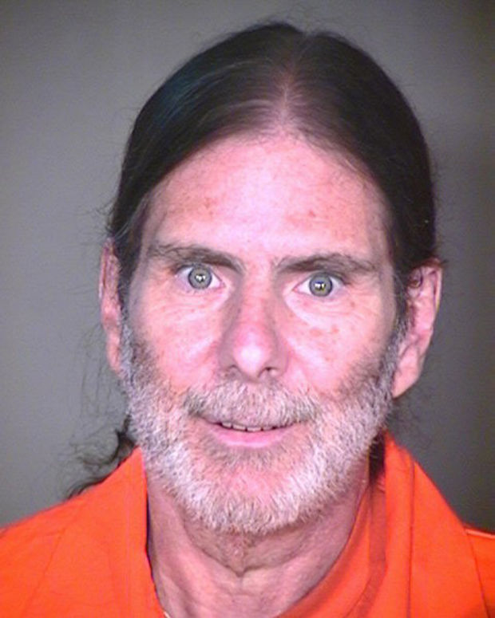
Where we are today…
Two appeals to the Supreme Court have been denied
Atwood now claims his attorney did an inadequate job representing him during his trial and sentencing
Atwood says he suffered from Post Traumatic Stress Disorder at the time of the murder but it was not brought up.
His current attorneys also say if his first lawyer had mentioned Atwood was a victim of child molestation and drug abuse, he might have been sentenced to life, instead of death.
On Monday, November 4th of this year there was a continuation of an Evidentiary Hearing from October
Stanton Bloom, Atwood’s privately retained trial and sentencing attorney testified that he was well aware of Atwood’s past but that Atwood had positive social interactions with him, his legal assistant, his mom, and other inmates throughout his trial.
The family is currently awaiting the verdict on this appeal….

Slide 11
Don’t forget Vicki Lynn
http://www.kvoa.com/videos/atwood-sentencing-anniversary-approaching/
http://www.youtube.com/watch?v=KH5MKFp3HVE

