Slide 1
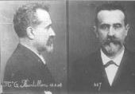
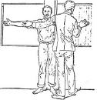
Alphonse Bertillon was
a French policeman
who believed that
people could be
physically identified
by conducting a series
of measurements.

Slide 2
Bertillon's system, anthropometrics, became popular during the 1880s.
Measurements included:
Body height
Outstretched reach of both arms
Trunk height
Width of the head
Length of the head
Width of the right ear
Length of the right ear
Length of the left foot
Length of the left middle finger
Length of the left little finger
Length of the the left forearm
In 1903, something occurred…
The case of Will West destroyed confidence in the Bertillon System literally overnight.

Slide 3
In 1903, a prisoner by the name Will West was sentenced to incarceration at the United States Penitentiary at Leavenworth, Kansas.
During his in processing, the records clerk obtained Will West's Bertillon measurements and photograph.
“You have been here before!”
Will West denied ever being incarcerated at the facility.

Slide 4
The records clerk, having referenced his Bertillon measurements into the system, retrieved the card for a William West.
Will West denied that the William West card was his.
Will West's Bertillon
Measurements
178.5
187.0
91.2
19.7
15.8
14.8
6.6
28.2
12.3
9.7
William West's Bertillon
Measurements
177.5
188.0
91.3
19.8
15.9
14.8
6.5
27.5
12.2
9.6

Slide 5
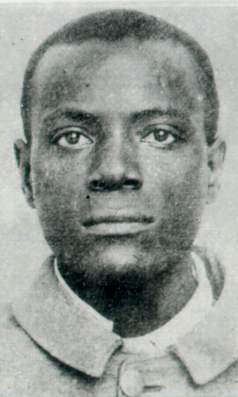
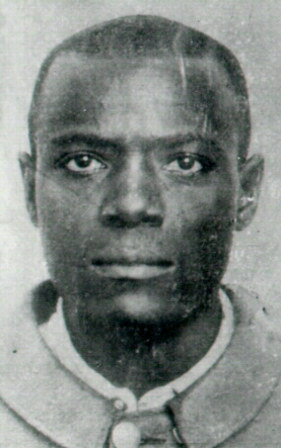
Subsequent investigation disclosed that William West was already incarcerated in the facility as of September 9, 1901.
William West was quickly produced, and everyone marveled at the similarities
Will West
William West

Slide 6
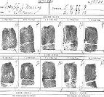
Perhaps they were related, therefore the closeness in measurements and appearance.
It didn’t matter…
As a result of this incident, the Bertillon system was later discarded in favor of fingerprints.

